Slide 1
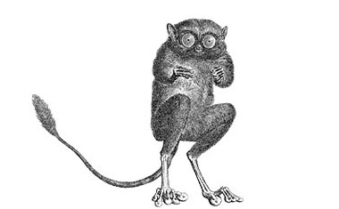
.
Frank Wu
frankwwu@hotmail.com
Twitter: @frankwwu
An Introduction to
Decision Trees with R
Boston Code Camp 26, November 19, 2016

Slide 2
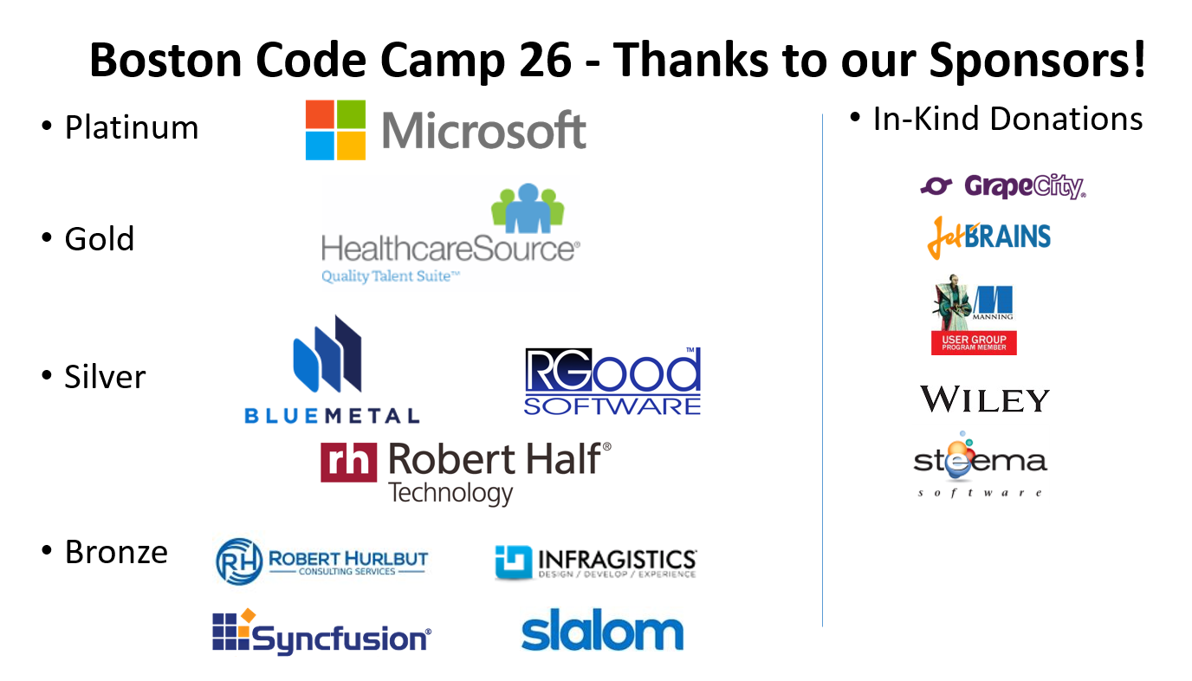

Slide 3
Timeline – ML, R, and Me
2012, Beginning Machine Learning in 60 Minutes, #BOSCC18
2013, Machine Learning with .NET , #BOSCC19
2014, R for C# Developers, #BOSCC21
2015, SQL Server Database Exploring with R, #BOSCC23
2015, Introduction R for SQL Server 2016 Developers, #BOSCC24
2016, Conquering Kaggle’s Machine Learning Challenge with R Tools for Visual Studio, #BOSCC25
2016, An Introduction to Decision Trees with R, #BOSCC26

Slide 4
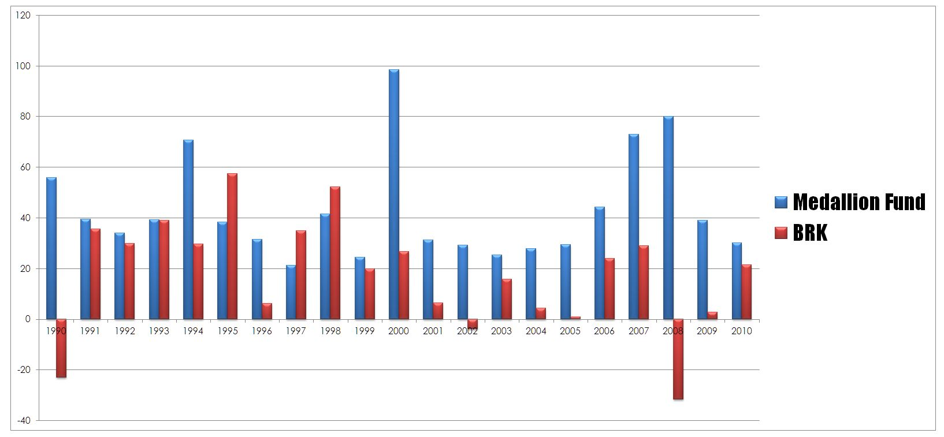


Who beats Warren Buffett?

Slide 5
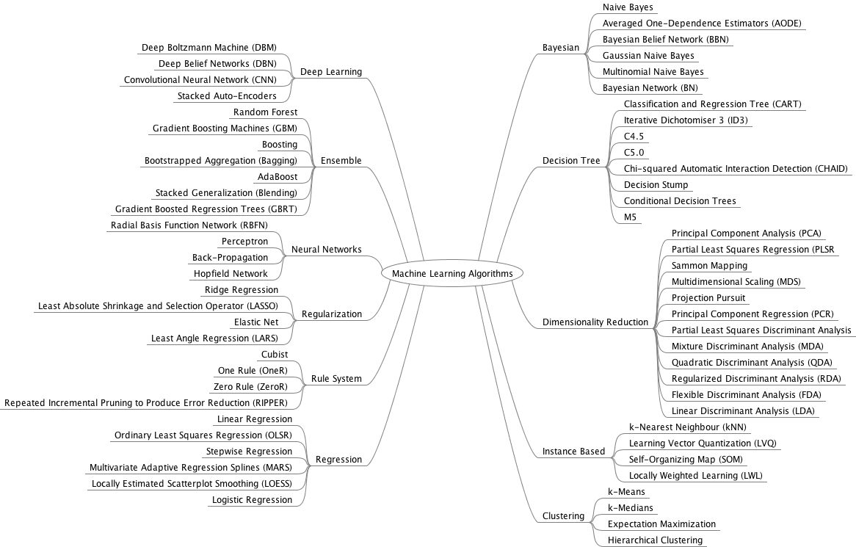
Who beats Warren Buffett actually?

Slide 6
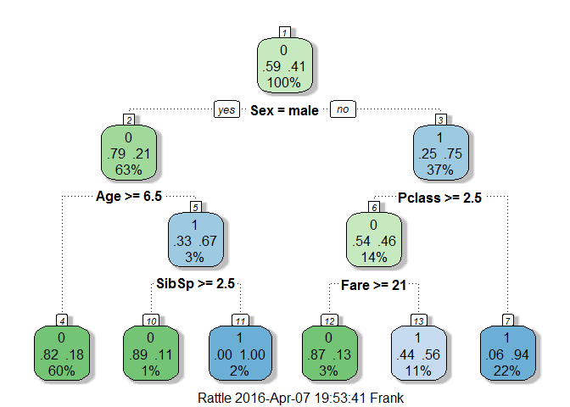
What are Decision Trees?
Supervised Learning
Recursively partition data into homogeneous groups

Slide 7
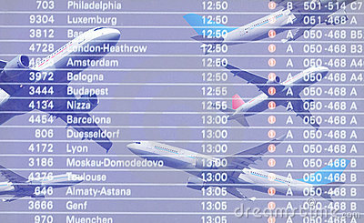
Classification Tree
Will the flight delay more than an hour? Boolean.
Regression Tree
How long will the flight delay? Numeric.

Slide 8
Decision Trees in R
Popular Packages:
rpart
caret
randomForest
ParallelForest
Tools and technologies
CRAN R, or Microsoft R
RStudio, or R Tools for Visual Studio
Notebook in Data Science Experience
literate programming
Markdown

Slide 9
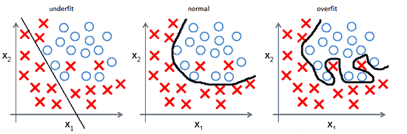
Underfit & Overfit

Slide 10
General steps for a Decision Tree problem
Read data
Clean data
Explore data
Feature engineering
Train -- the tree model
Cross-validation
Prune the tree
Prediction – test

Slide 11
Limitation
Instability
One output per attribute

Slide 12
Further reading
Random Forests
Gradient Boosting Machine (GBM)

Slide 13
Q&A

